Slide 1
TPM Guidebook and TPM CMM Launch
Transportation Performance Management
Web Room: https://connectdot.connectsolutions.com/sr500tpmwebroom
Toll-Free number: 1-800-683-4564 Access Code: 912454
December 5, 2016

Slide 2
Welcoming Remarks
Peter J. Stephanos | FHWA
Director, Office of Transportation Performance Management

Slide 3
Agenda
TPM Overview/Toolbox Purpose
The TPM Toolbox
Q&A
TPM Toolbox Demo
Q&A
Stakeholder Perspective
Conclusion

Slide 4
What is TPM?
Transportation Performance Management is a strategic approach that uses system information to make investment and policy decisions to achieve national performance goals.
Notes:
In short, Transportation Performance Management:
Is systematically applied, a regular ongoing process
Provides key information to help decision makers allowing them to understand the consequences of investment decisions across transportation assets or modes
Improvescommunications between decision makers, stakeholders and the traveling public.
Ensures targets and measures are developed in cooperative partnerships and based on data and objective informati

Slide 5
TPM Professional Capacity Building Program
Goal: to ensure transportation agencies and local partners are prepared to carry out performance-based decision-making
Elements:
FHWA-sponsored training
FHWA-sponsored workshops
TPM capacity development pooled fund
TPM implementation review survey
Let’s Talk Performance webinar series
Notes:
Key Message: The TPM Toolbox is one element of many within the TPM Professional Capacity Building Program that provides technical assistance in various forms.
Training to include: basic, target setting, regulation, implementation
Pooled fund: developed by RiDOT, administered by AASHTO. Members of pooled fund will define assistance needs and make it available to other members. Will also develop clearinghouse of TPM resources.
Survey: establish baseline to 1) determine readiness to implement regulations and 2) determine effectiveness of PBPP/TPM Webinars: sharing of noteworthy practices

Slide 6
Purpose of the TPM Toolbox
Allow agencies to assess current TPM capabilities
Outline actions to improve upon current capabilities
Provide implementation steps and examples from agencies nationwide
Provide a collection of TPM resources
Move the TPM state-of-practice forward

Slide 7
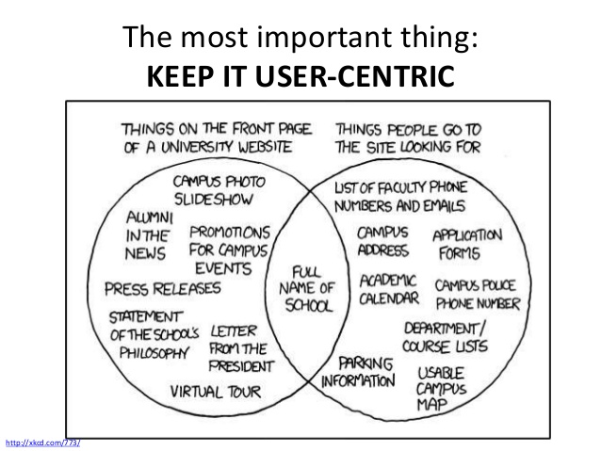
Why Launch www.TPMTools.org as a Public Beta?
Notes:
Why a Public Beta. It allows us to collect feedback from you and test bugs at an important phase in the project to make sure we are on the right track before we start locking the sites user interface and design down. We want to make sure the site serves your needs and you can find what you are look for. This is an ambitious site and with your feedback it will serve you’re an TPM ambitions.

Slide 8
The TPM Toolbox

Slide 9
Toolbox Elements
Notes:
These tools allow agencies to continually assess their TPM practice and how it is improving over time.
Agencies can self-assess periodically, and use the results in combination with the guidebook, resources, and consortium to implement and improve TPM processes.
These tools are NOT intended as MAP-21 compliance guidance, but working TPM into agency processes brings a lot of benefits.

Slide 10
Implementation Process
1
Assess maturity level
Determine action steps
Review Implementation Steps
Develop/ undertake action plan
Iterate and improve
5
2
4
3
Notes:
Key Message: This is model of the implementation process using the TPM Toolbox tools and other resources. The tools should be used in an iterative cycle of improvement over time.
Step 1, assess maturity level of overall TPM at your agency using the TPM Capability Maturity Self-Assessment
Step 2, the CMM provides actions to advance in maturity. Use these as a starting point for action planning.
Step 3, use the TPM guidebook excerpts provided in the results of the self-assessment – review them and consider how to apply to your agency.
Step 4, flesh out those action items into an action plan with milestones, roles and responsibilities, etc.
Step 5, repeat the process – perhaps after a year - by using the self-assessment to re-assess your agency’s (hopefully improved) maturity level. Repeating the cycle is key to continuous improvement.

Slide 11
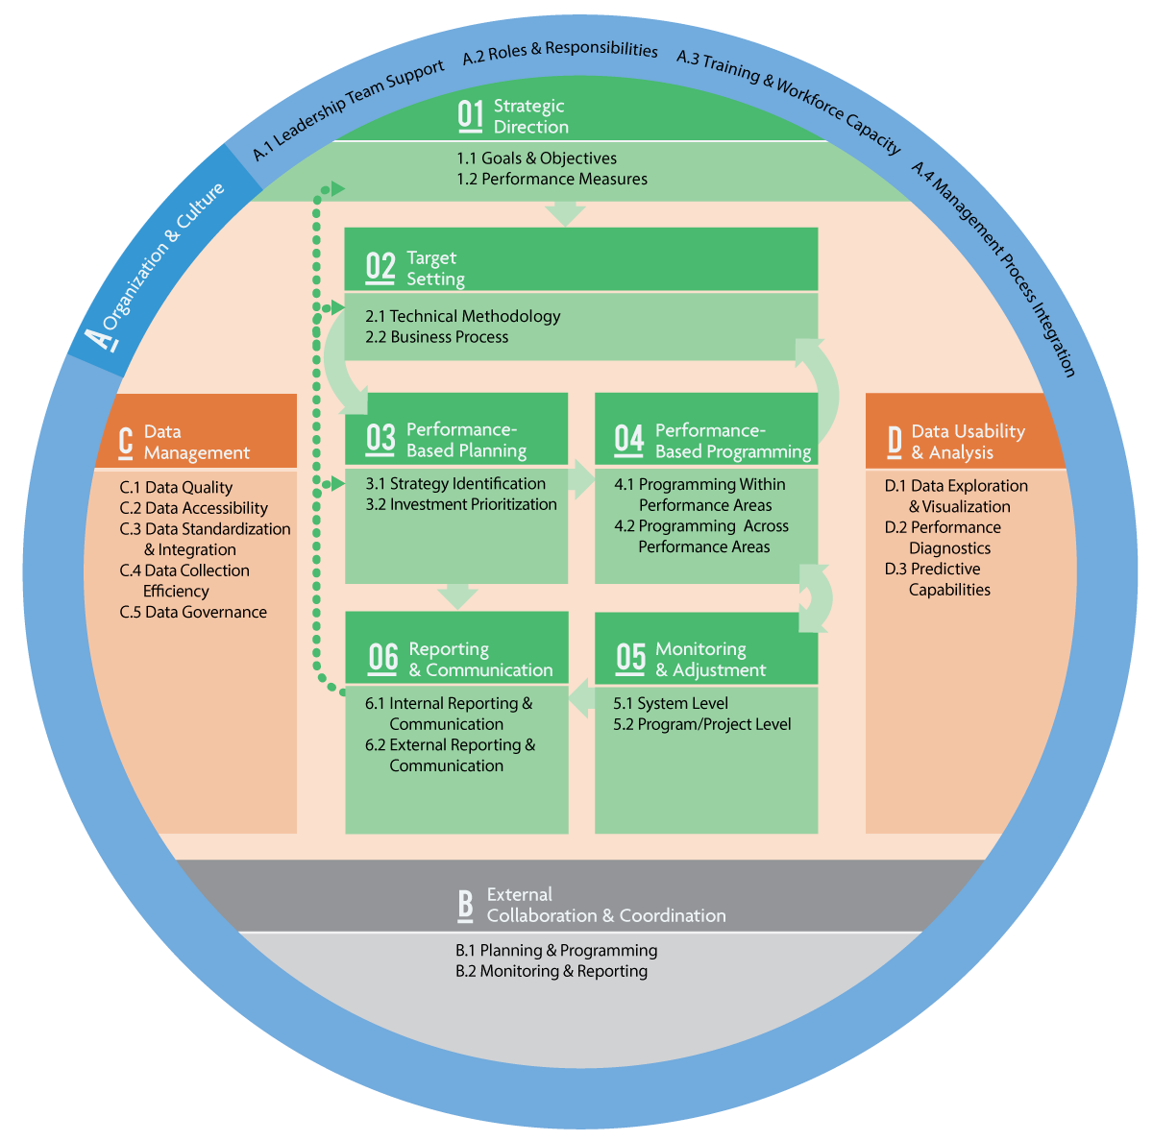
TPM Framework
Notes:
Key Message: This circular diagram is the TPM Framework, and includes the 10 TPM Components and how they relate to each other.

Slide 12
TPM Framework
1. Strategic Direction
2. Target Setting
3. Performance-Based Planning
4. Performance-Based Programming
5. Monitoring & Assessment
6. Reporting & Communication
A. Organization & Culture
B. External Collaboration & Coordination
C. Data Management
D. Data Usability & Analysis
CMM has 10 components
with 26 Subcomponents
Notes:
The TPM Framework was developed as a way to visualize the 10 components of TPM.
For those of you familiar with the performance-based planning and programming framework, much of this circle will look similar. There are a few changes, mainly in how components are laid out and shaded:
Green are central processes
Orange are data-related
Gray and blue are supporting/fundamental components
Each component is also broken down into subcomponents, which vary in number by component.
Our workshops with state DOTs can stay at the component level or can detail subcomponents depending on the state of the practice at the DOT.
Target setting, for example, can be broken down into Technical Methodology and Business Processes.

Slide 13
CMM: Capability Maturity Model
Purpose
Assess current state of your agency
Identify logical set of improvements
Show benefit of moving to higher maturity levels
Scope
Assesses maturity on 1-5 scale
For each TPM Component
Notes:
Key Message: A capability maturity model is a way to assess an organization’s capability.
The TPM CMM provides a way for agencies to assess their current state and identify a set of improvement actions.
It uses a 1-5 scale.
Background: This form of maturity models was first created by Carnegie Mellon in 1991 for the US Gov’t to assess software contractors.
They have been widely adopted since, including in the transportation industry.
Examples include TSM&O and FHWA INVEST Assessment.
FHWA’s INVEST (Infrastructure Voluntary Evaluation Sustainability Tool) is a web-based self-evaluation tool comprised of voluntary sustainability best practices, called criteria, which cover the full lifecycle of transportation services, including system planning, project planning, design, and construction, and continuing through operations and maintenance. FHWA developed INVEST for voluntary use by transportation agencies to assess and enhance the sustainability of their projects and programs.

Slide 14
TPM CMM Levels of Maturity
Level | Definition
1.Initial | Ad hoc, uncoordinated, firefighting, champion-dependent
2.Developing | Nominal framework (e.g., organizational roles) being defined and systematic approaches starting to emerge
3.Defined | Framework and systems defined but not fully implemented or effectively supporting decision making
4.Functioning | TPM practices have been institutionalized, information used to guide actions, data improvements being pursued, basic predictive and tradeoff capabilities in place
5.Sustained | TPM will survive across new leadership, managers using performance information, data effectively managed, and external stakeholders view performance results as useful in promoting accountability and transparency
Notes:
Each of those components and subcomponents can be evaluated for your agency based on maturity.
On the screen are the generic definitions for each level of maturity, with a 1- being initial (meaning its still pretty reliant on a champion)…
…and a 5 being sustained (mature processes have been institutionalized).
The 5 levels of maturity have been tailored to each of the 10 components and 26 sub-components listed in the TPM Framework.

Slide 15
TPM Capability Maturity Self-Assessment
Interactive online tool
Agencies use to determine their maturity level (1-5)
Results
Maturity level
Actions to move to next level (from CMM)
Excerpts from the guidebook related to Actions
Notes:
Key Message:
The self-assessment turns the capability maturity model into an interactive online tool that agencies can access.
Individual results include three things for each component:
maturity level,
actions to move to the next level and
a link to excerpts from the guidebook related to actions.

Slide 16
TPM Capability Maturity Self-Assessment
FHWA use of results
Develop and tailor technical assistance
Identify noteworthy practices and leading states
Monitor emerging TPM trends
FHWA will NOT use to assess compliance
Notes:
FHWA use of results
Develop and tailor technical assistance
Identify noteworthy practices and leading states
Monitor emerging TPM trends
FHWA will NOT use to assess compliance

Slide 17
Relation to Other Frameworks and Tools
Notes:
Key Message: The TPM Framework fits into other tools and frameworks that you might be familiar with.
The TPM CMM allows an agency to assess TPM at a high level, either across the whole agency or within a particular performance area.
The assessment always includes all components to get a holistic perspective.
Occasionally, maturity can be difficult to self-assess:
Others throughout the organization know more about the agency’s expertise
Level of maturity can vary depending on topic area (e.g. Safety vs. Economic Development)
Other, more detailed assessment tools, such as TSM&O and others, allow you to dive deeper into a particular focus area. So, all these tools are related, but assess different things at different levels of specificity.

Slide 18
TPM Guidebook
Focuses on “how” rather than “what”
Implementation steps and related agency examples
Self-contained and modular
Note: not intended for regulatory
compliance
Notes:
A lot of material exists to explain the topics within TPM, so this Guidebook took a different path – it focuses on concrete implementation steps that agencies can follow to implement or improve TPM practices.
Each implementation step has an agency example to provide a real-world illustration of the step.
The different components and subcomponents (remember the TPM Framework) can be read separately or together – everything is interrelated, but the chapters are written in a way that allows you to read just what you need, not the whole guidebook.
The guidebook is not intended to be a roadmap for meeting federal rule requirements. However, by implementing TPM, your agency will likely be better equipped to meet and exceed requirements.

Slide 19
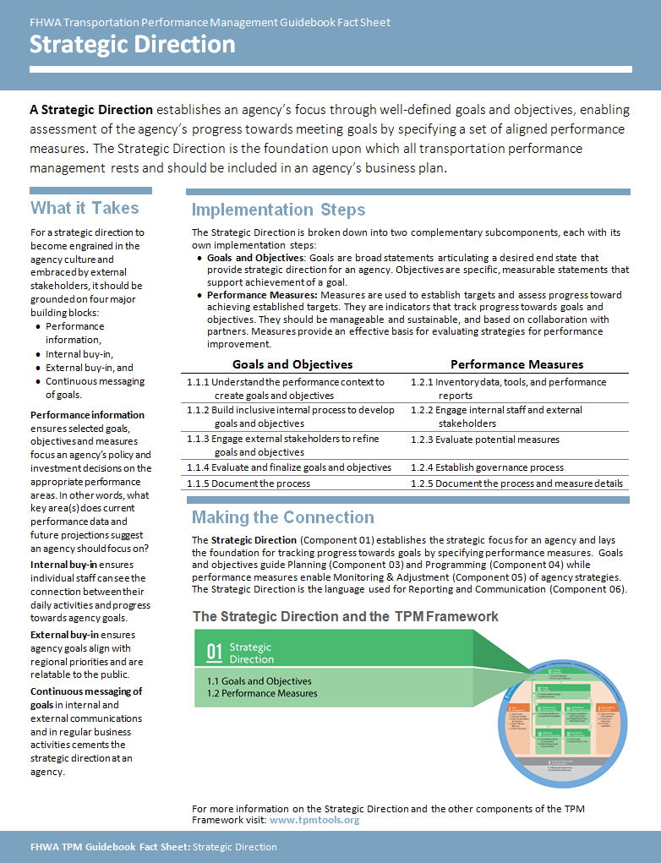
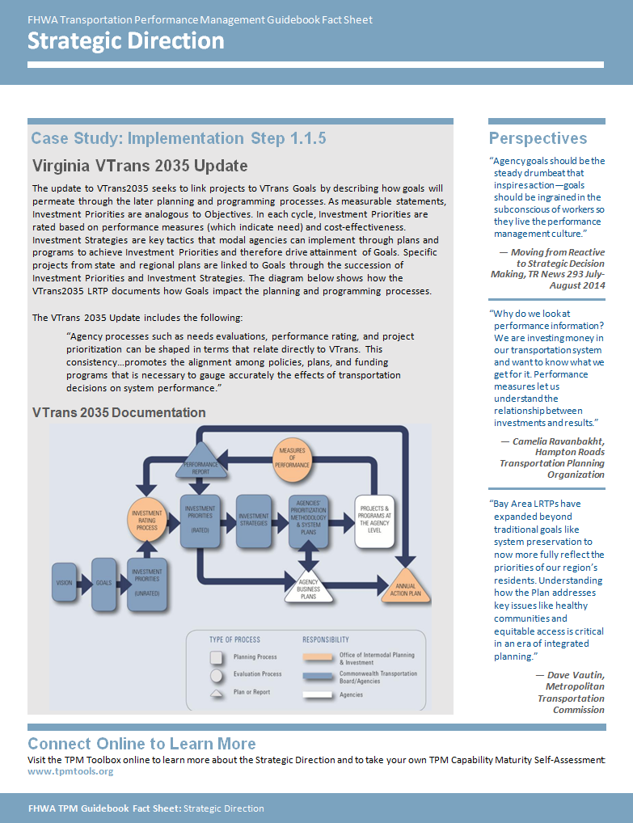
TPM Guidebook Fact Sheets
Notes:
Key Message: Each chapter has a fact sheet.
These are high level summaries of the chapters that can be used to quickly educate staff or leadership.
These were created because of multiple requests by stakeholders for a condensed version of the chapters.
They include the component definition, subcomponents, implementation steps, relationship to other components, one selected example, and quotes from the chapter.

Slide 20
Practitioner Consortium
Database of public agency employees with TPM expertise
To be used by FHWA/FTA and state agency staff to identify experts
Dynamic filtering
Coming soon!
Notes:
Key Message: The consortium is a database of public agency employees with TPM expertise. Agencies and FHWA/FTA can use to identify participants, experts, speakers, or peer staff for implementation assistance.
The database will allow filtering to find individuals by expertise, geography, agency type, and other characteristics. This is a tool that will roll out later.
Background: Names were collected from participant rosters from TPM events 2010-2015.
Names, contact information, expertise, and other information will be included in TPM Toolbox, but likely with password protection or other mechanism.
Need to balance this with creating a resource for people to use as they implement…
Accuracy will be ongoing process as people move jobs, but we are building a mechanism for people to update their information via a link.
Will eventually be sending an info-gathering request through AASHTO, AMPO, and APTA to have people self-identify areas of expertise as well as their willingness to participate in various activities.

Slide 21
TPM Resources
Compilation of NCHRP, SHRP2, FHWA, and others
Provide additional detail and background for 10 TPM Components
Categorized by Component, TPM area, and resource type
Notes:
Key Message: Provides TPM-related resources in a single location online, providing additional information on 10 components.
Resources are also listed at the end of each Component chapter as well as in the appendix.
With the guidebook focused on how to implement TPM, the resources tool allows agencies to learn more about the “what” of TPM using existing resources.
This tool provides filtering capabilities, and each resource has a short description and a direct link to that resource.

Slide 22
Questions?

Slide 23
Site Demonstration

Slide 24
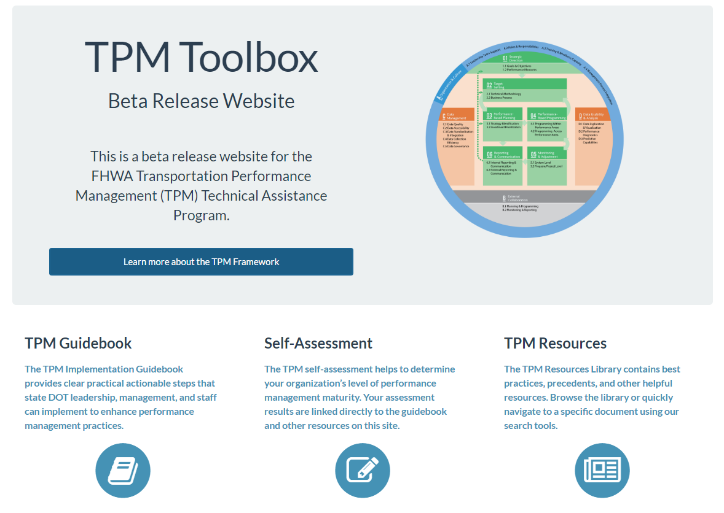
TPM Toolbox Homepage

Slide 25
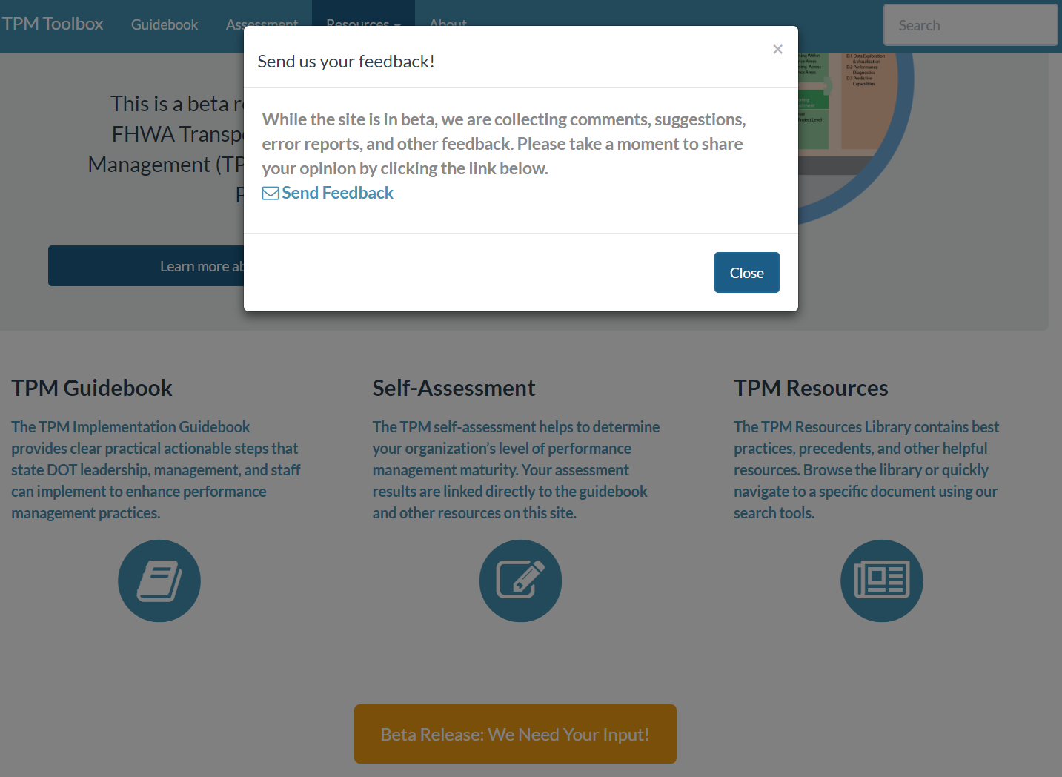
TPM Toolbox Homepage

Slide 26
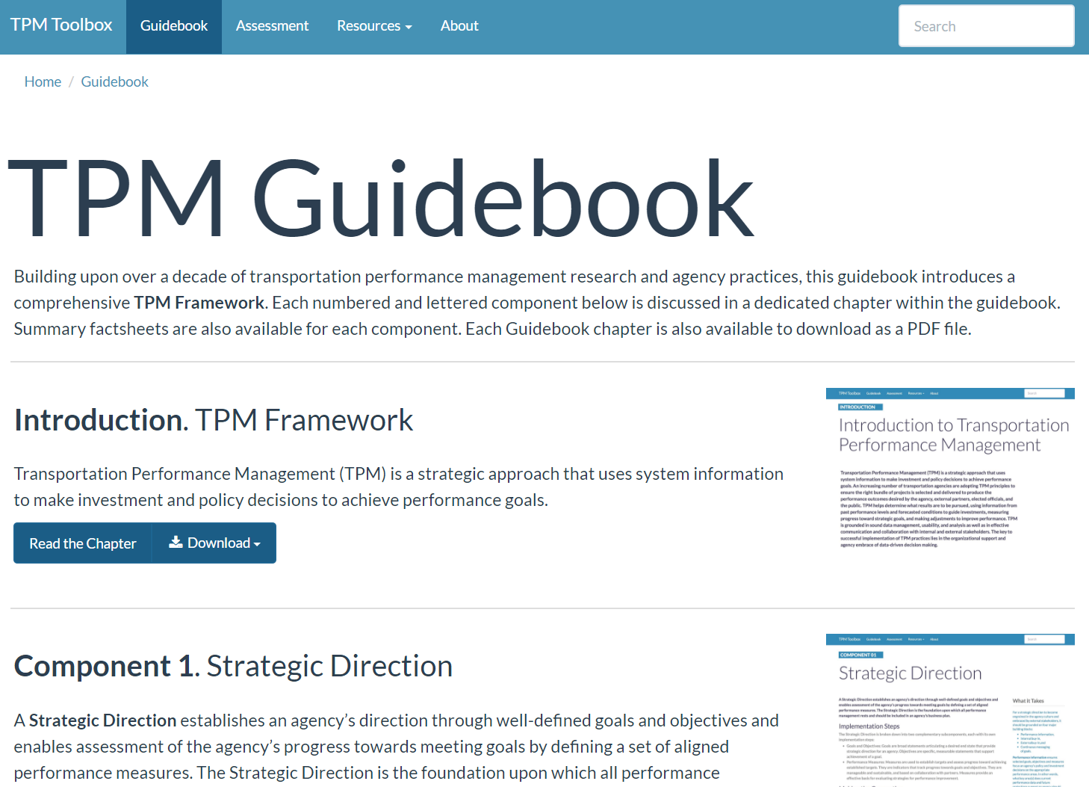
TPM Guidebook

Slide 27
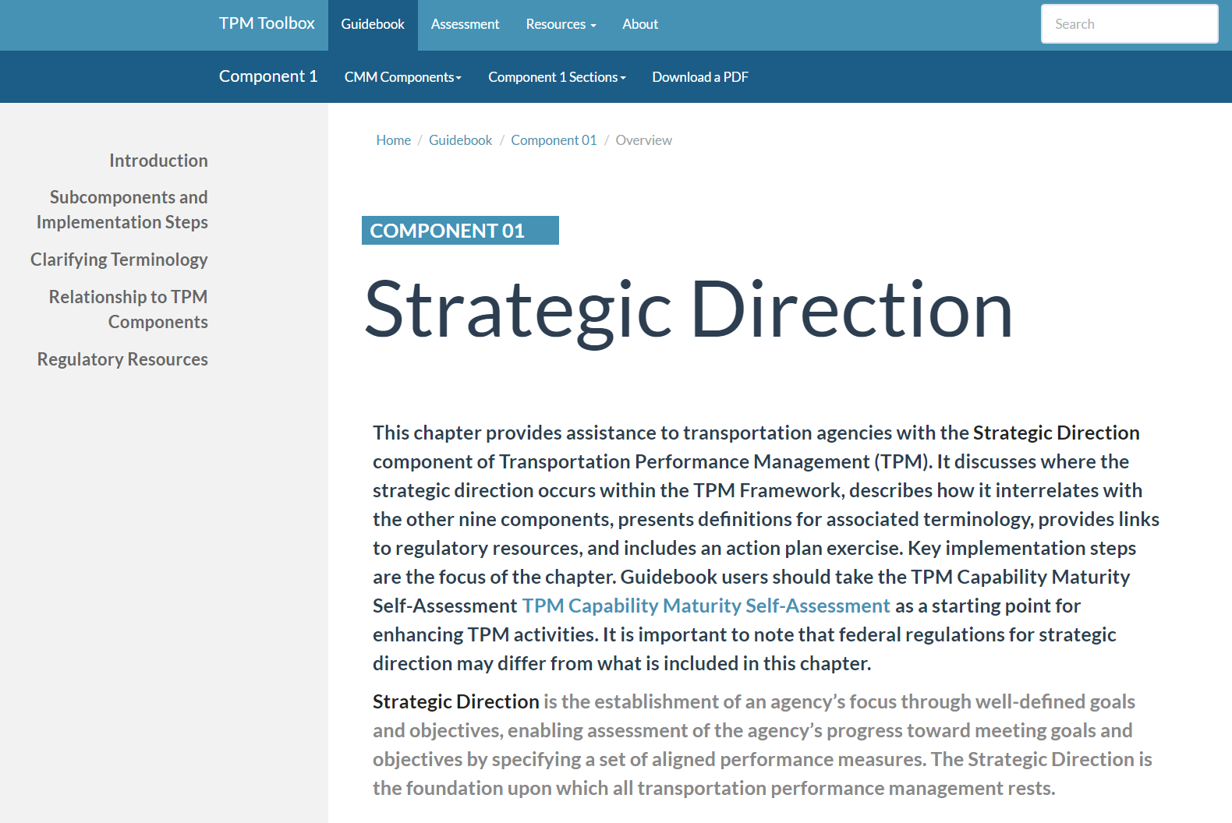
TPM Guidebook: Component 1

Slide 28
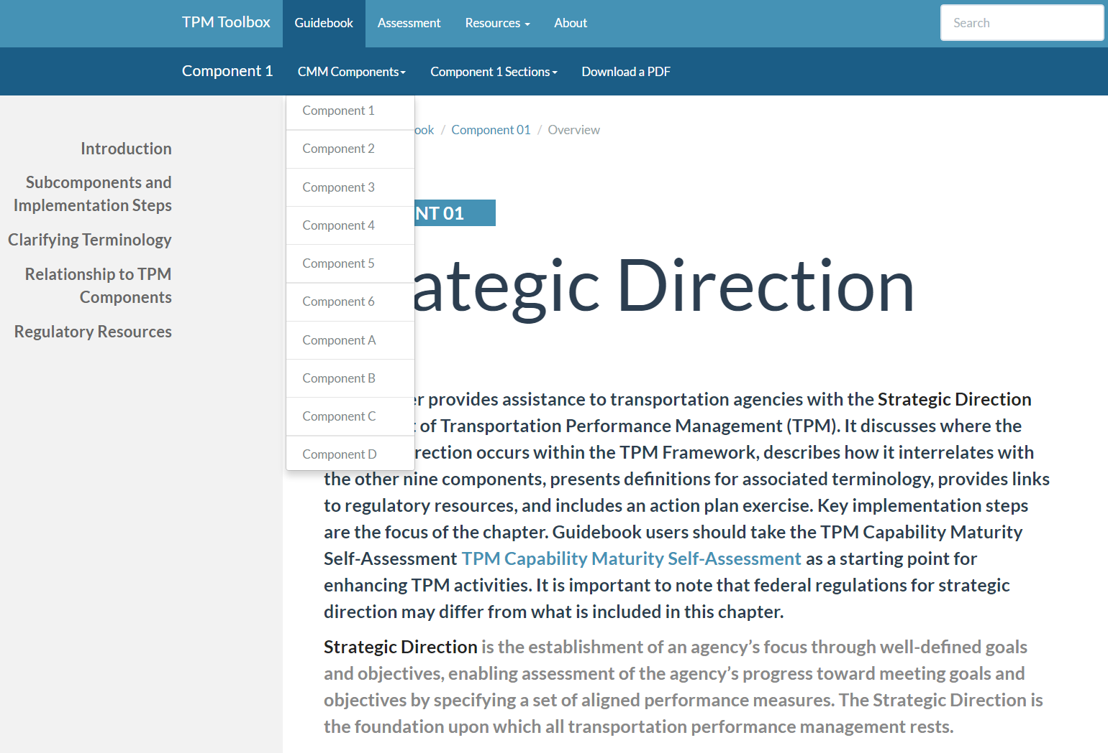
Component Navigation

Slide 29
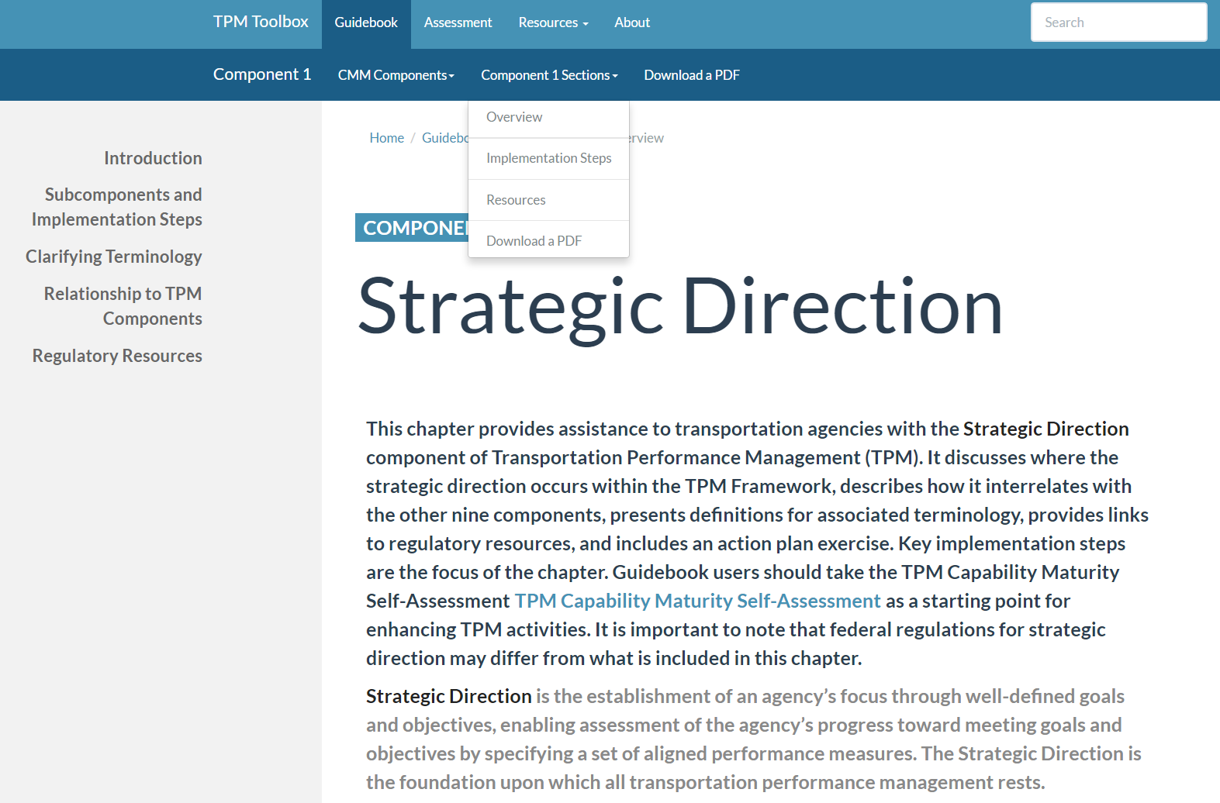
Section Navigation

Slide 30
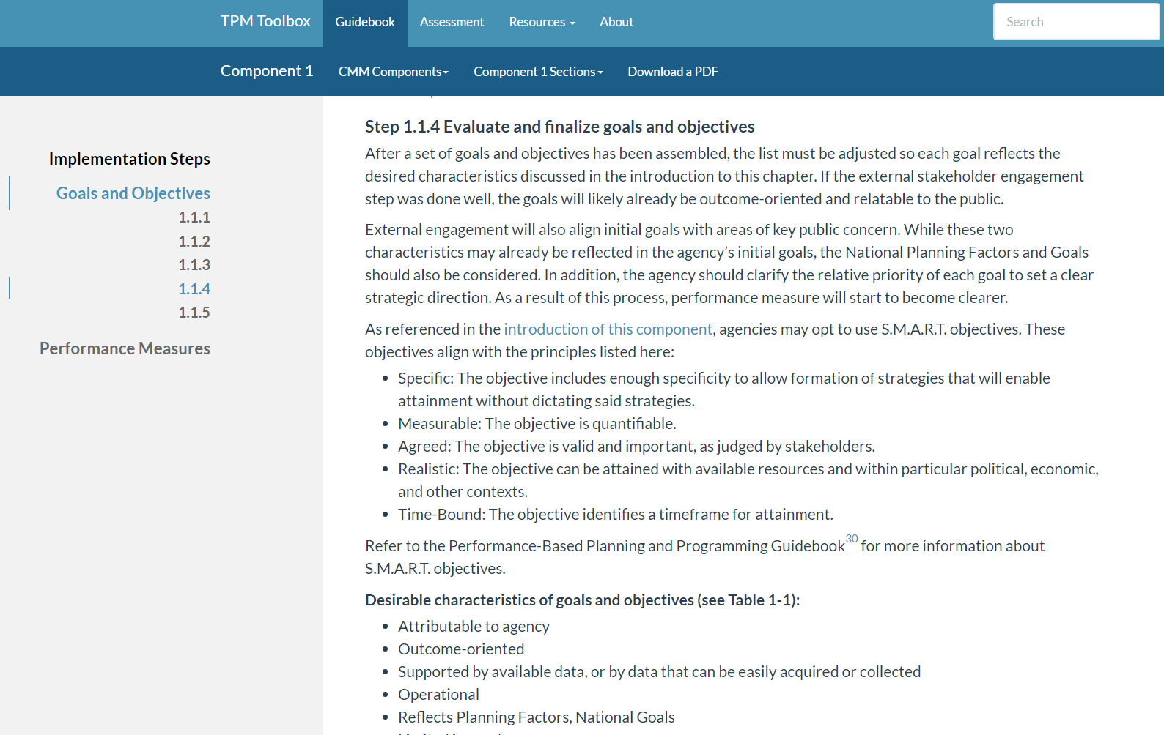
Section Navigation

Slide 31
Section Navigation
Send us feedback on the navigation menus!

Slide 32
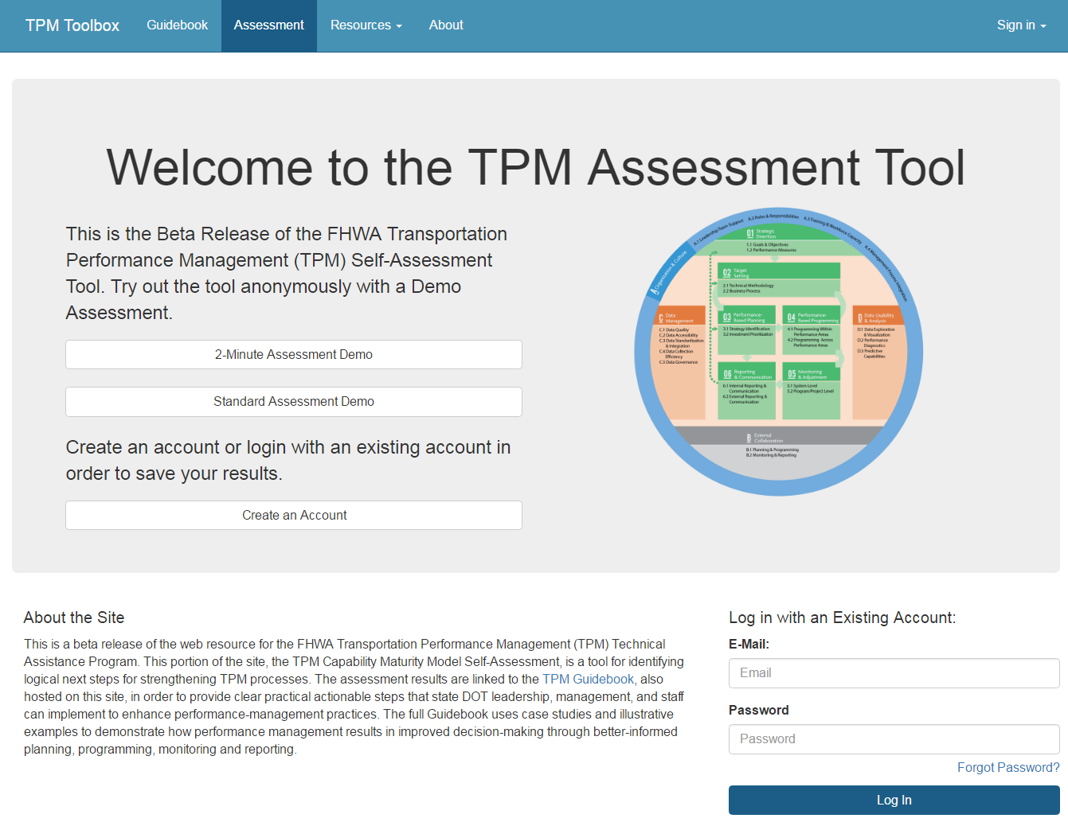
Self-Assessment Homepage

Slide 33
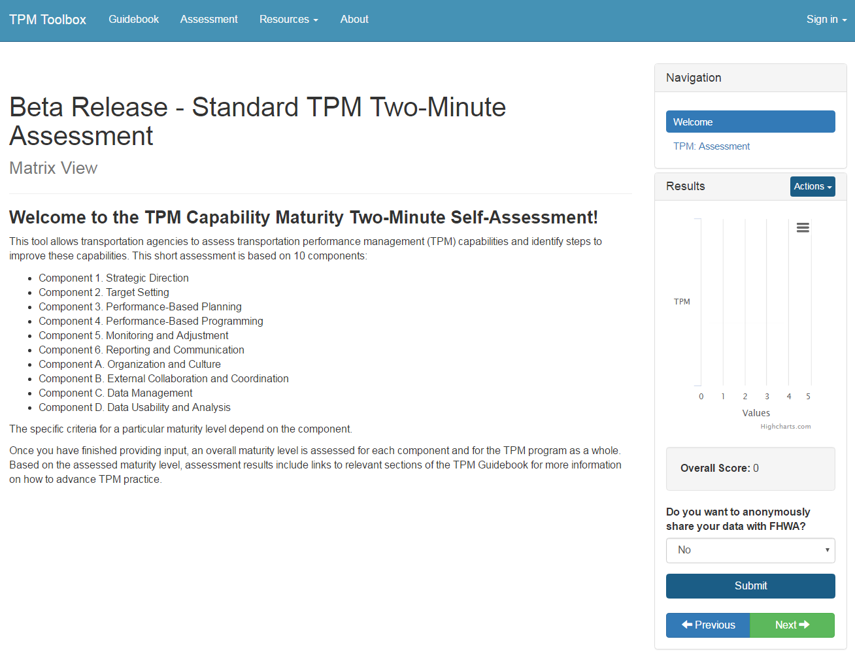
Short Self-Assessment

Slide 34
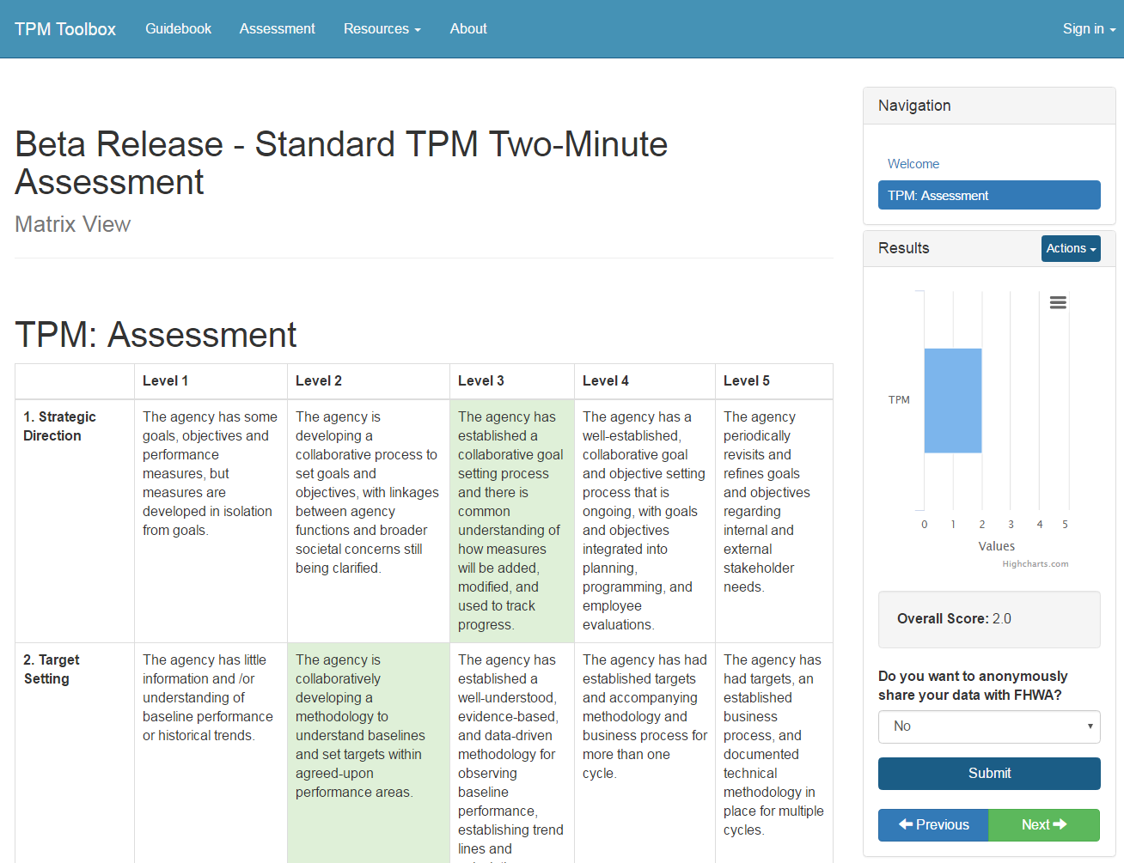
Short Self-Assessment

Slide 35
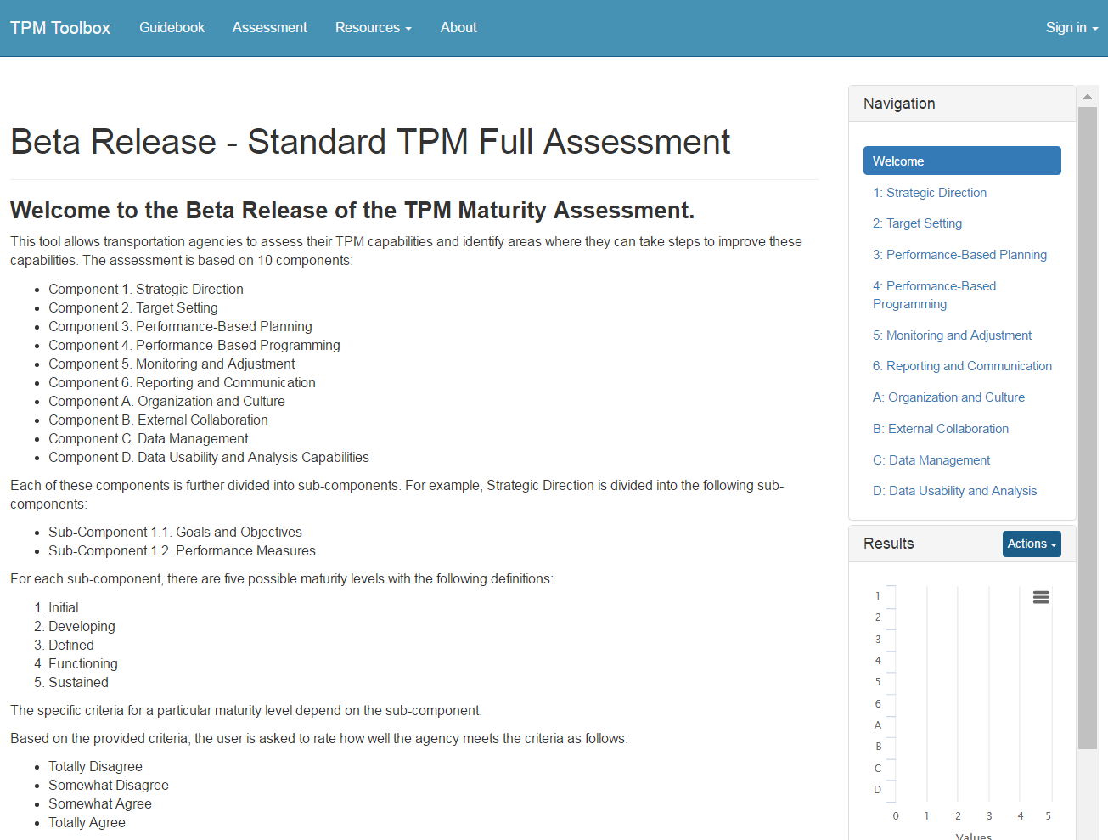
Long Self-Assessment

Slide 36
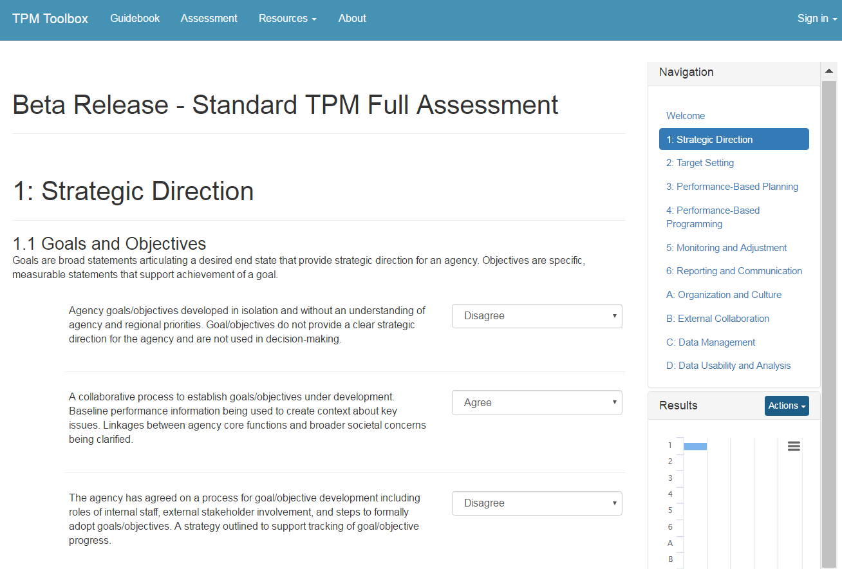
Long Self-Assessment

Slide 37
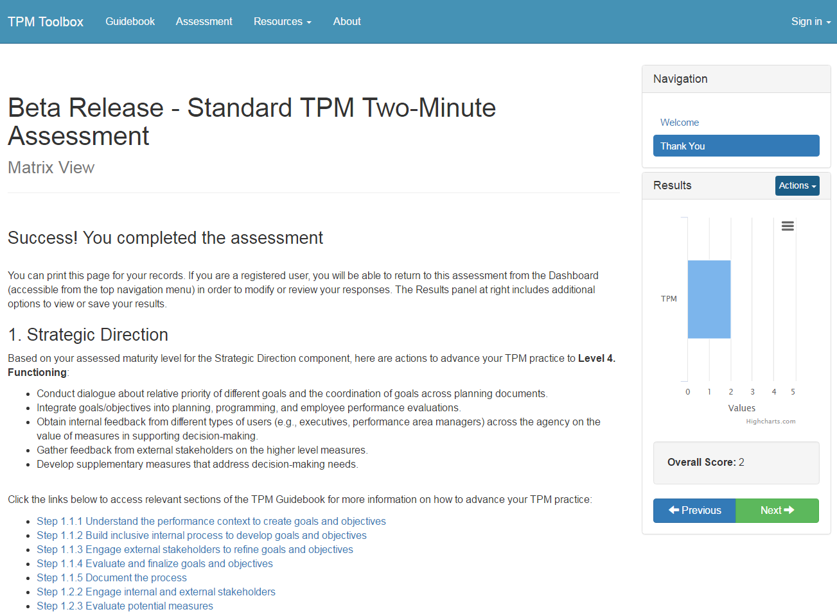
Self-Assessment Results

Slide 38
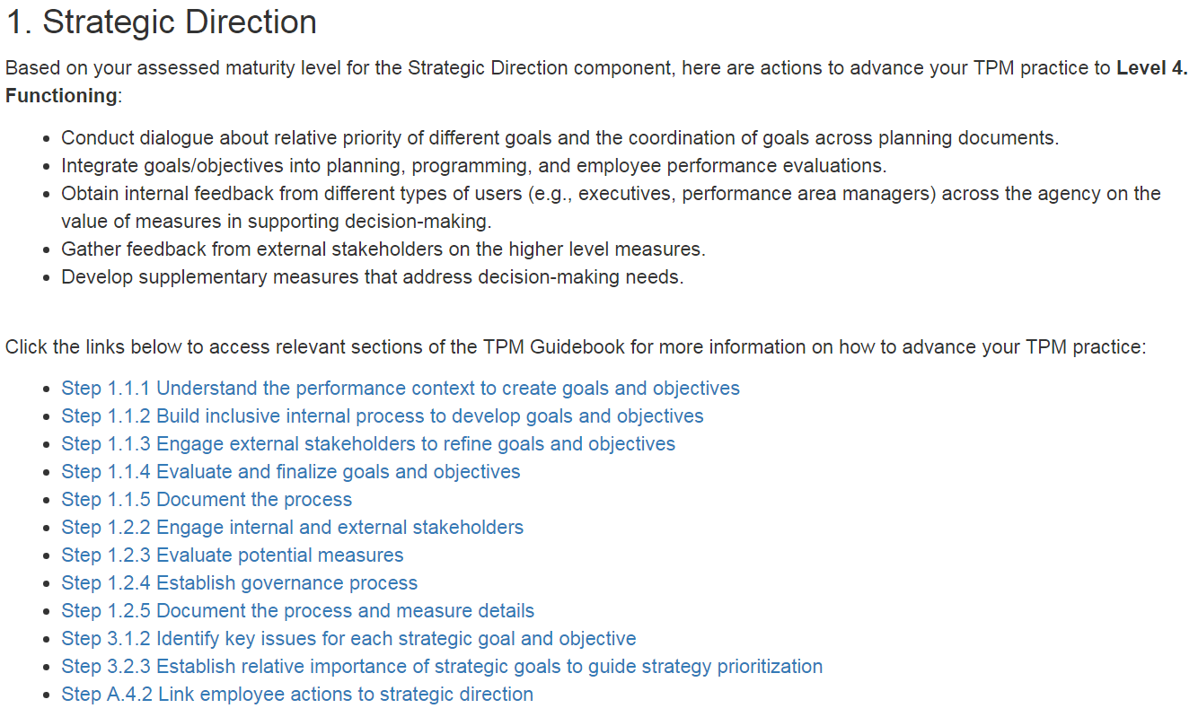
Self-Assessment Results

Slide 39
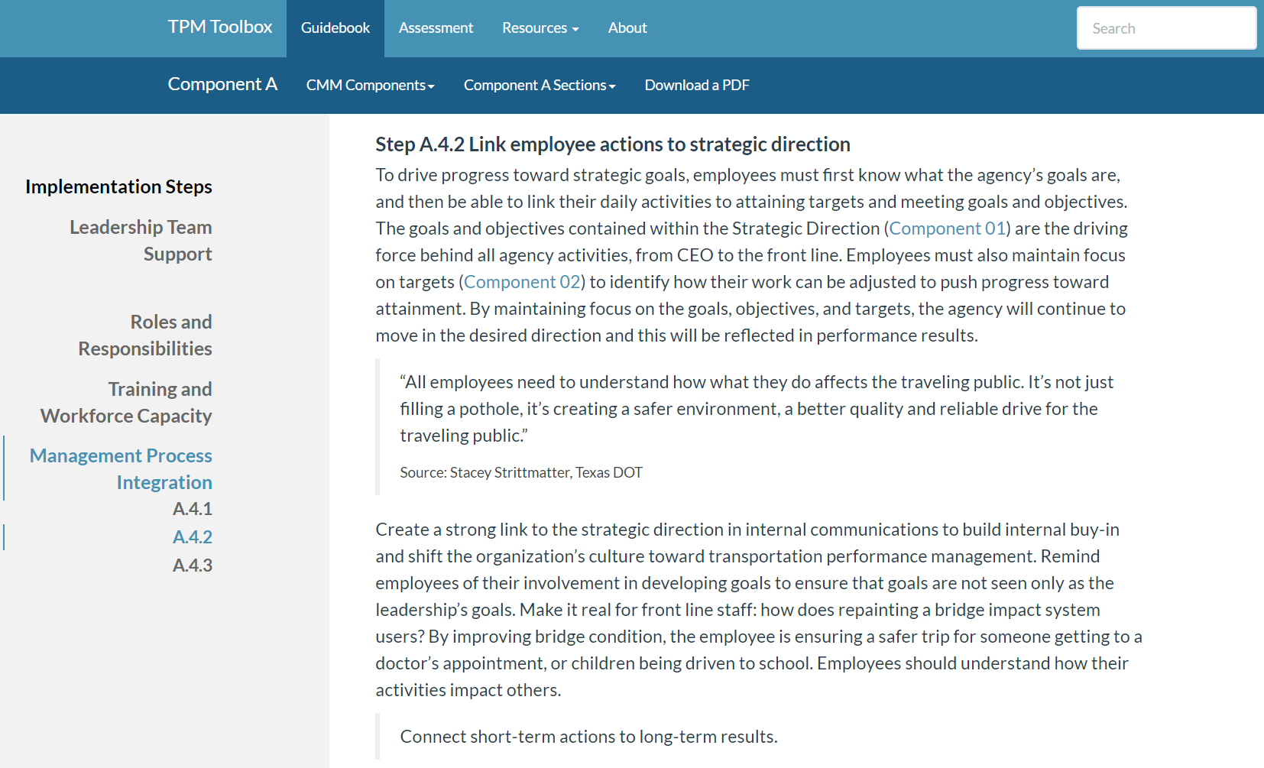
Self-Assessment Results

Slide 40
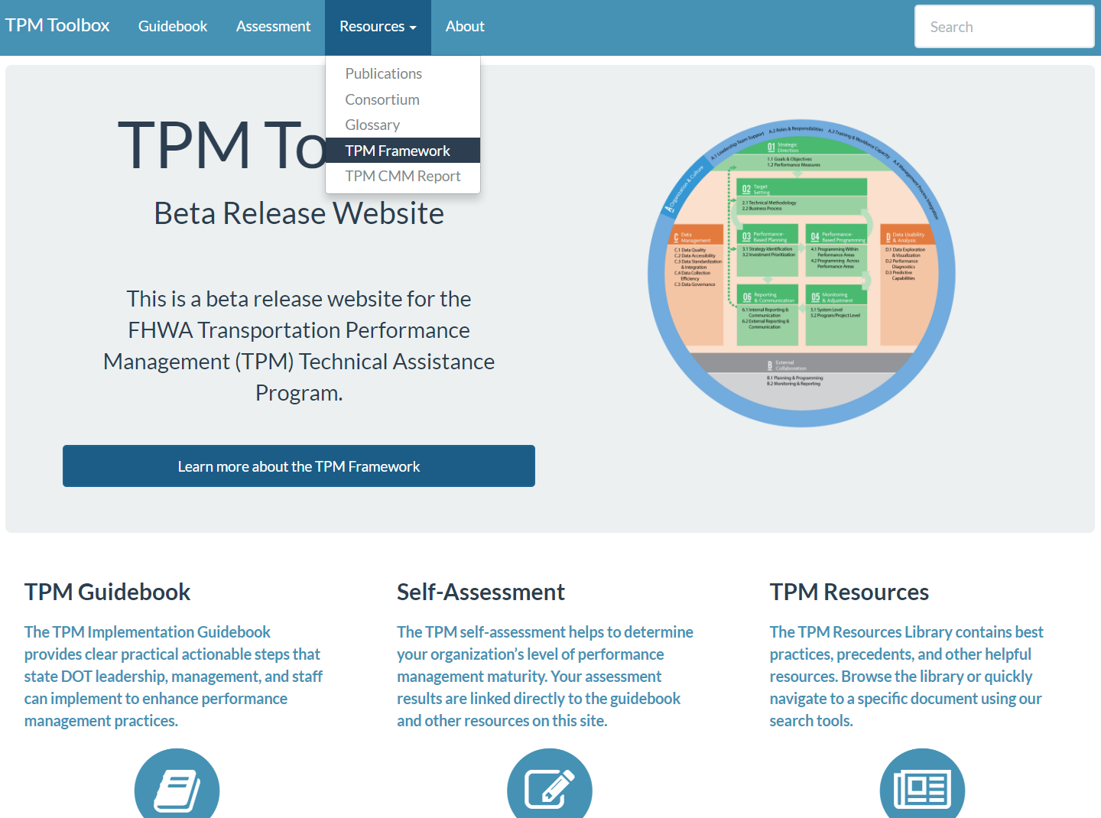
TPM Resources

Slide 41
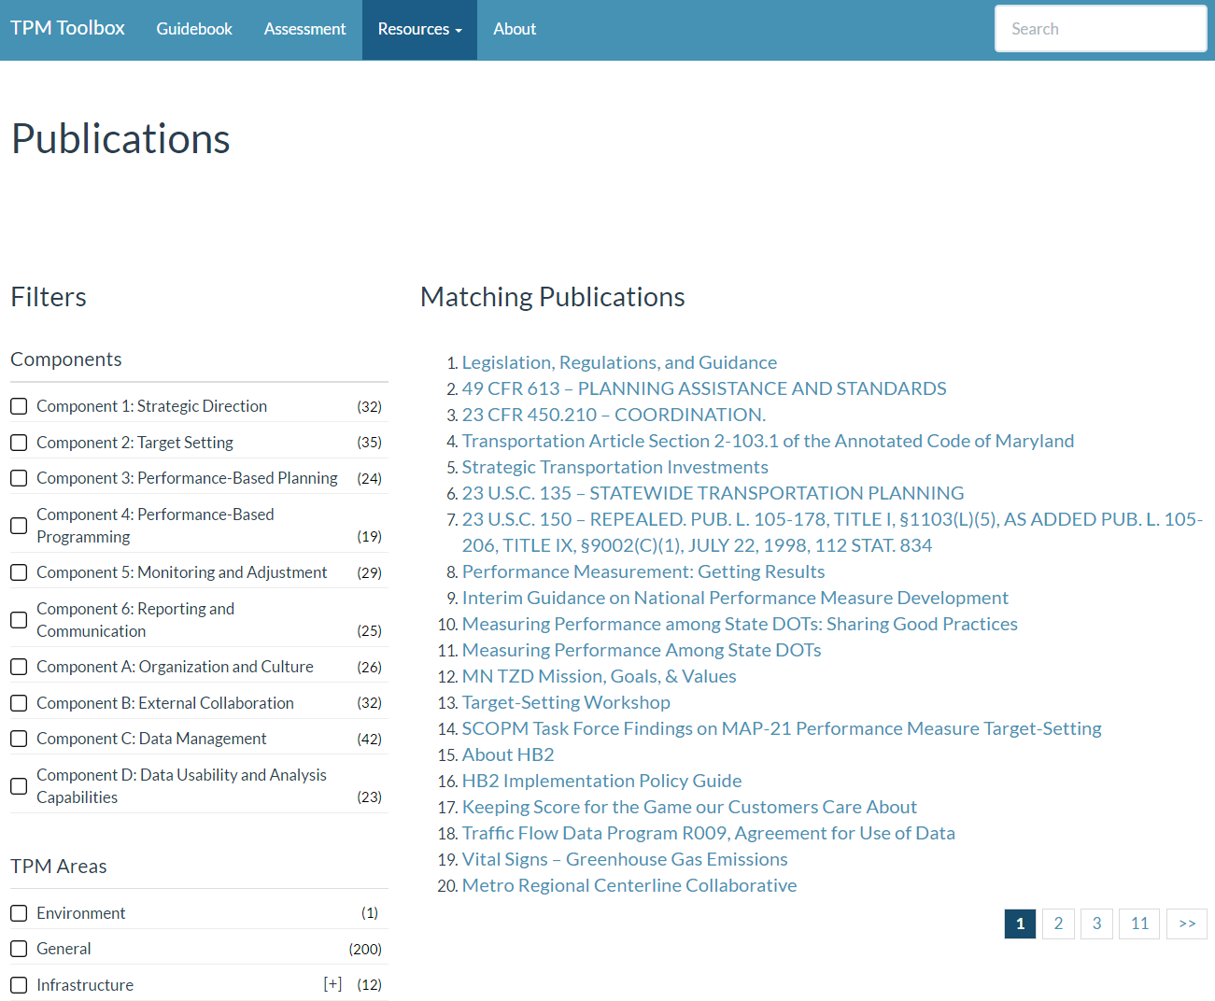
TPM Resources

Slide 42
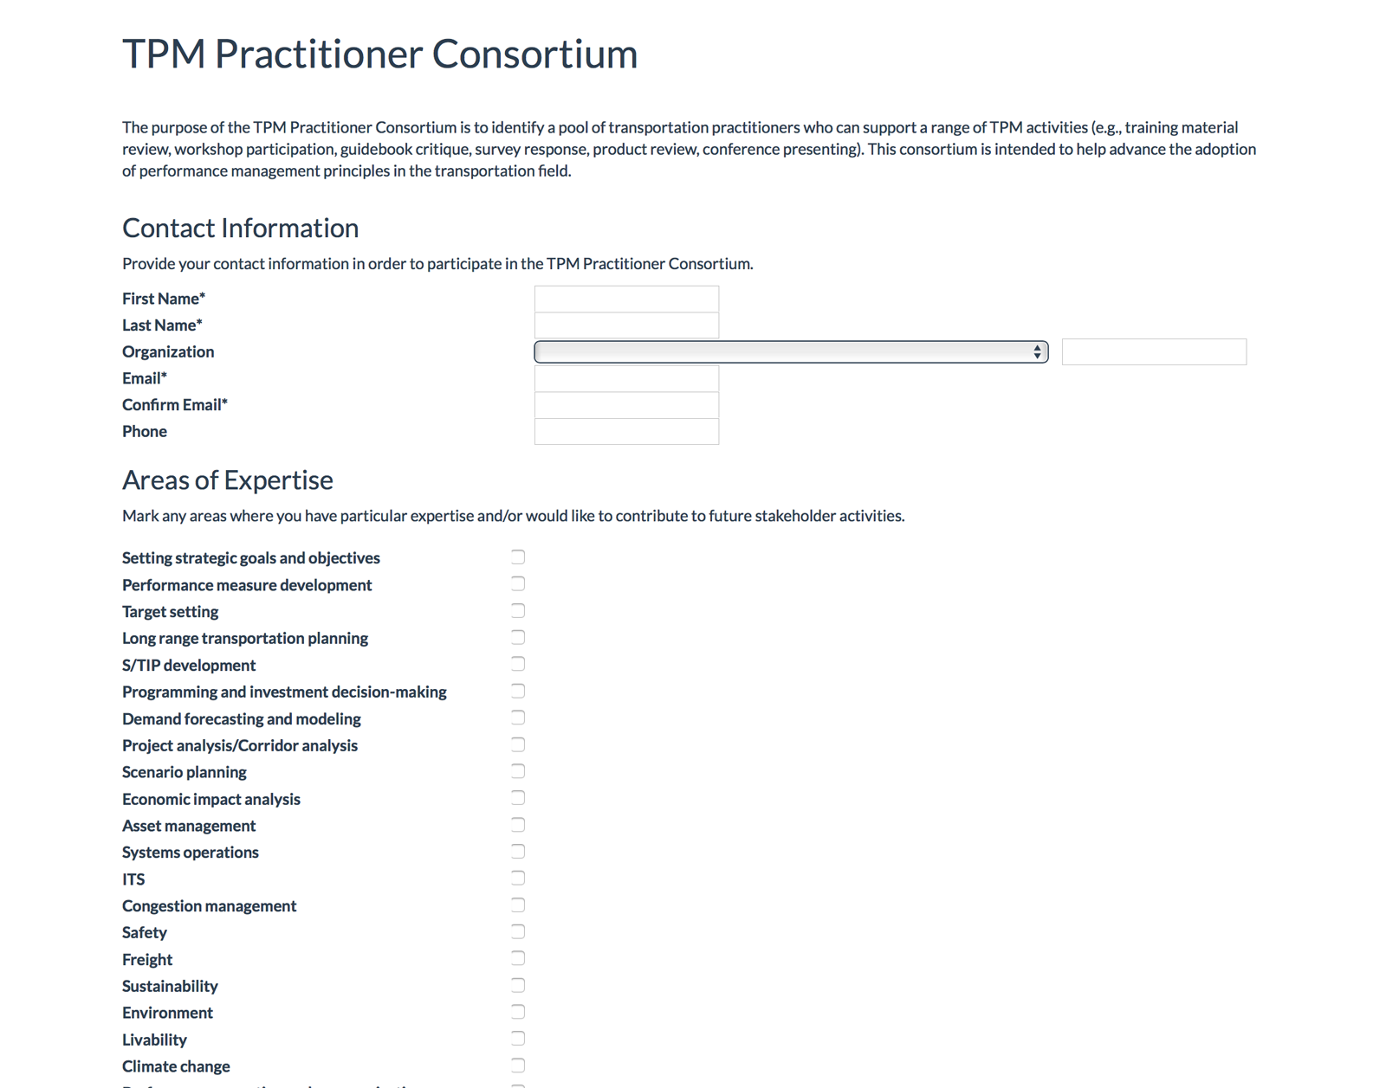
TPM Consortium
Coming soon!

Slide 43
Questions?

Slide 44
Stakeholder Perspective

Slide 45
Stakeholder Perspective
Stakeholders Input
Best Practices
Applicable to all Agencies
Business Model
Collaboration
Beyond FAST Act/ MAP-21

Slide 46
Workshop Planning
Executive Buy-in
Area(s) of Focus
Identification of Participants
Workshop Framework
Coordination Calls
Self Assessment prior to Workshop
TPM CMM Introduction Webinar

Slide 47
TPM Framework
Notes:
Key Message: Transportation performance management, or TPM, is a strategic approach that uses system information to make investment and policy decisions to achieve performance goals. It allows agencies to be more thoughtful in selecting projects to produce performance outcomes in line with agency goals such as complete streets or transit-oriented development.
This circular diagram is the TPM Framework, and includes the 10 TPM Components and how they relate to each other.

Slide 48
Workshop Planning
Executive Buy-in
Area(s) of Focus
Identification of Participants
Workshop Framework
Coordination Calls
Self Assessment prior to Workshop
TPM CMM Introduction Webinar

Slide 49
During the Workshop
Agency Specific Assessment Results
Interactive Agenda
Mixed Agency Breakouts
Agency by Agency Breakouts
Agency Specific Action Plans
Two Things Needed
Two Things to Contribute

Slide 50
Benefits
Usable by Any Agency
Best Practices
Action Plans
Workshop Collaboration

Slide 51
Next Steps
Explore the Tool
Guidebook
Self-Assessment
Provide beta feedback
Determine Scope of Use at your Agency
Develop Prioritized List of Components
Request a Workshop
Review Periodically

Slide 52
Wrap-up

Slide 53
Features Under-development in December
Enhanced Save/Print Assessment Results
Practitioners Consortium
Changing navigation menus to component name rather than "Component x”
Ability to label and save assessments by Performance Area
Other user interface refinements
Notes:
WE have number of features under development that will be available by the end of december hopefully

Slide 54
TPM Self-Assessment Workshops/Peer Exchanges (to-date)
Peer Exchanges
May 2016 :TPM Data Management
Self-Assessment Workshops
August 2016: Missouri (Data Management and Data Usability)
September 2016: Michigan (Target Setting and Monitoring and Adjustment)
October 2016: AMPO Annual Meeting (Safety Target Coordination)
November 2016: Tennessee (Safety Target Coordination)
December 2016: New Mexico (Strategic Direction and PBPP)
January 2017: Arkansas (Target Setting and PBPP)
More to come in 2017!!
Notes:
Please remember we use all these tools during our TPM Workshops and if you would like a to be considered for workshop submit a request.

Slide 55
Request TPM Capacity Building Assistance
TPM Capacity Building Program
http://www.fhwa.dot.gov/tpm/tpmrequest/
Training opportunities
TPM Workshops and Peer-to-Peer assistance
Sign-up for the TPM Newsletter
Explore WWW.TPMTOOLS.ORG!
Notes:
To request TPM specific training, use the link listed to submit a request form. Also review the two attached informational handouts on upcoming TPM Training and Capacity Building opportunities.
Visit the website to sign-up for the TPM newsletter to be notified when new training is made available.

Slide 56
Contacts
FHWA
Michael Nesbitt, Office of TPM: michael.nesbitt@dot.gov
Spy Pond Partners
Scott Richrath: srichrath@spypondpartners.com
Chris Plano: cplano@spypondpartners.com
Notes:
Notes: Ask for any closing thoughts from host – maybe they can remind participants that they should be honest in responding, because this information is to help them only (not used for any other reason).

